Slide 1
Experimental Results
All_IVCs Algorithm

Slide 2
Overhead of different algorithms
Algorithm | min | max | avg | stdev
IVC_MUST | 13.731% | 10530.769% | 1081.099% | 1613.265%
IVC_UC | 0.0% | 100.0% | 10.226% | 11.718%
IVC_UCBF | 14.092% | 11124.432% | 882.018% | 1512.071%
* Overhead = (running time of the algorithm)/ (JKind verification time) * 100

Slide 3
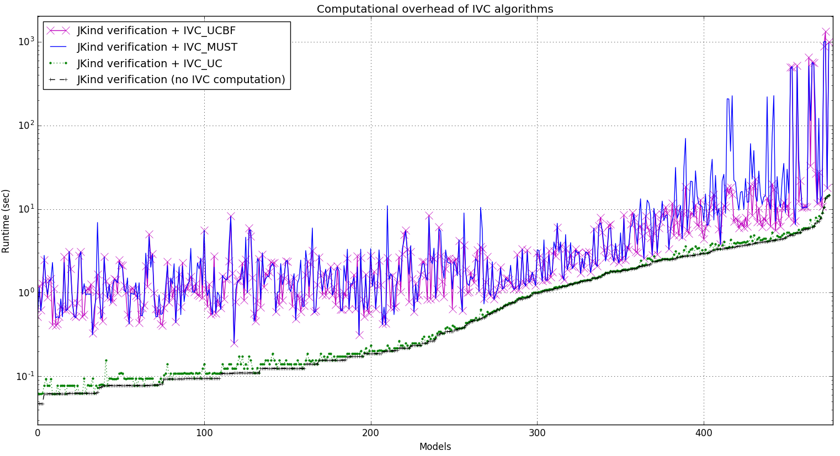

Slide 4
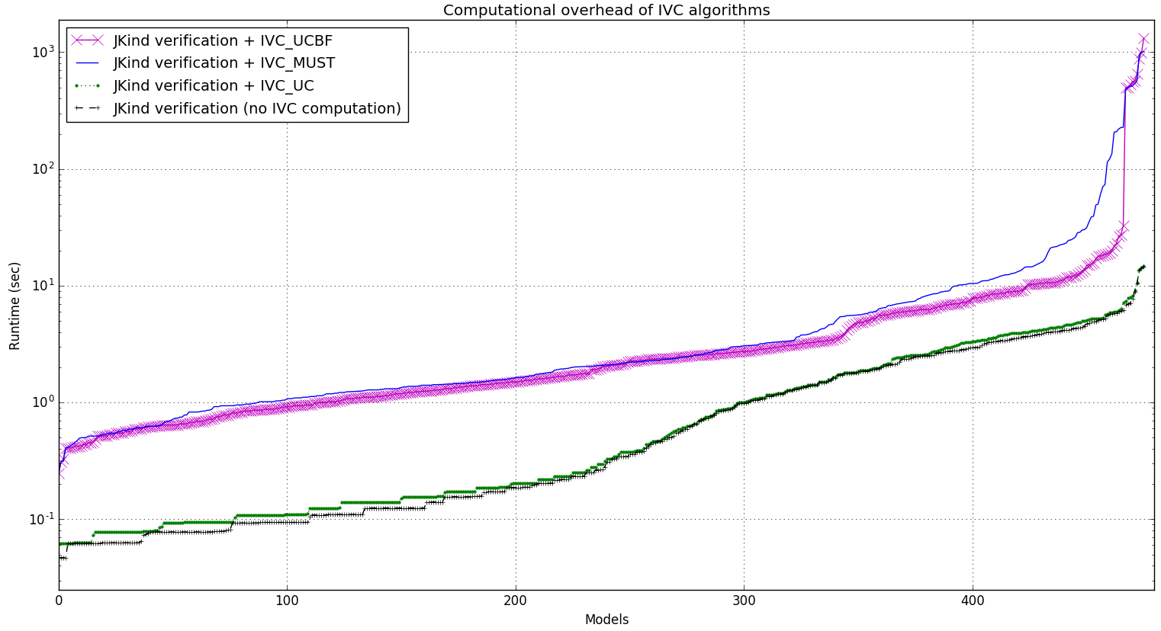

Slide 5
Running time of different algorithms
Running time (sec) | min | max | avg | stdev
IVC_UC + proof time | 0.062 | 14.758 | 1.384 | 2.046
IVC_UCBF + proof time | 0.248 | 1323.515 | 17.247 | 104.838
IVC_MUST + proof time | 0.25 | 1010.829 | 20.641 | 98.979
Proof time | 0.047 | 14.617 | 1.299 | 1.940

Slide 6
Coverage of different algorithms
IVC sizes | min | max | avg | stdev
IVC_UC | 1 | 141 | 12.741 | 15.986
IVC_UCBF | 1 | 141 | 12.174 | 16.092
IVC_MUST | 1 | 129 | 11.644 | 15.027
Ratio of IVC sizes | min | max | avg | stdev
IVC_UC to IVC_UCBF | 100% | 360% | 110.5% | 23.0%
IVC_MUST to IVC_UCBF | 13.3% | 100% | 95.9% | 12.1%
IVC_UC to IVC_MUST | 100% | 825% | 119.5% | 47.3%

Slide 7
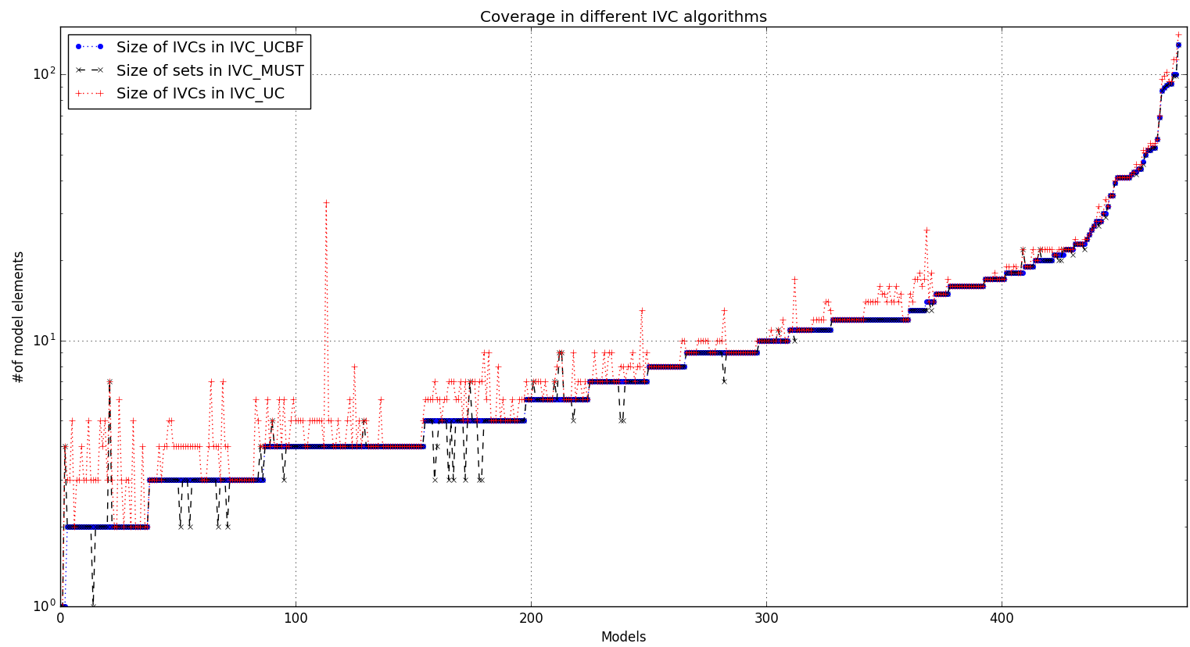

Slide 8
Info on IVC_MUST minimization runs
Running time (sec) | avg | stdev
All runs among all models | 0.9 | 8.28
VALID runs among all models | 2.54 | 4.74
INVALID runs among all models | 0.16 | 0.39
UNKNOWN runs among all models | 125.28 | 0.32
Info on IVC_UCBF minimization runs
Running time (sec) | avg | stdev
All runs among all models | 0.78 | 7.91
VALID runs among all models | 3.3 | 2.95
INVALID runs among all models | 0.16 | 0.41
UNKNOWN runs among all models | 141.07 | 0.81

Slide 9
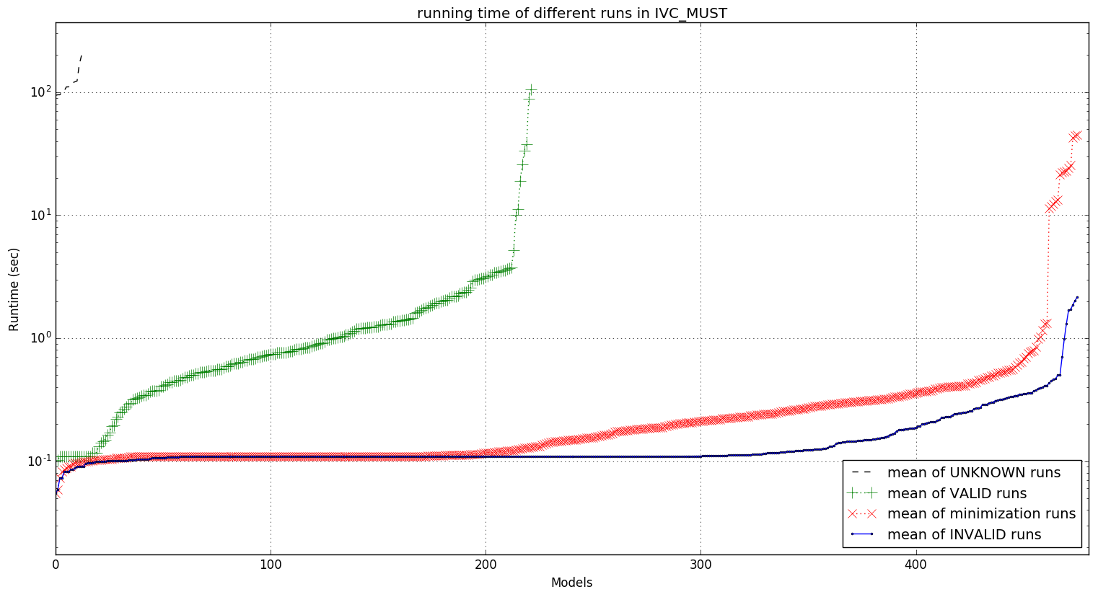

Slide 10
